Slide 1
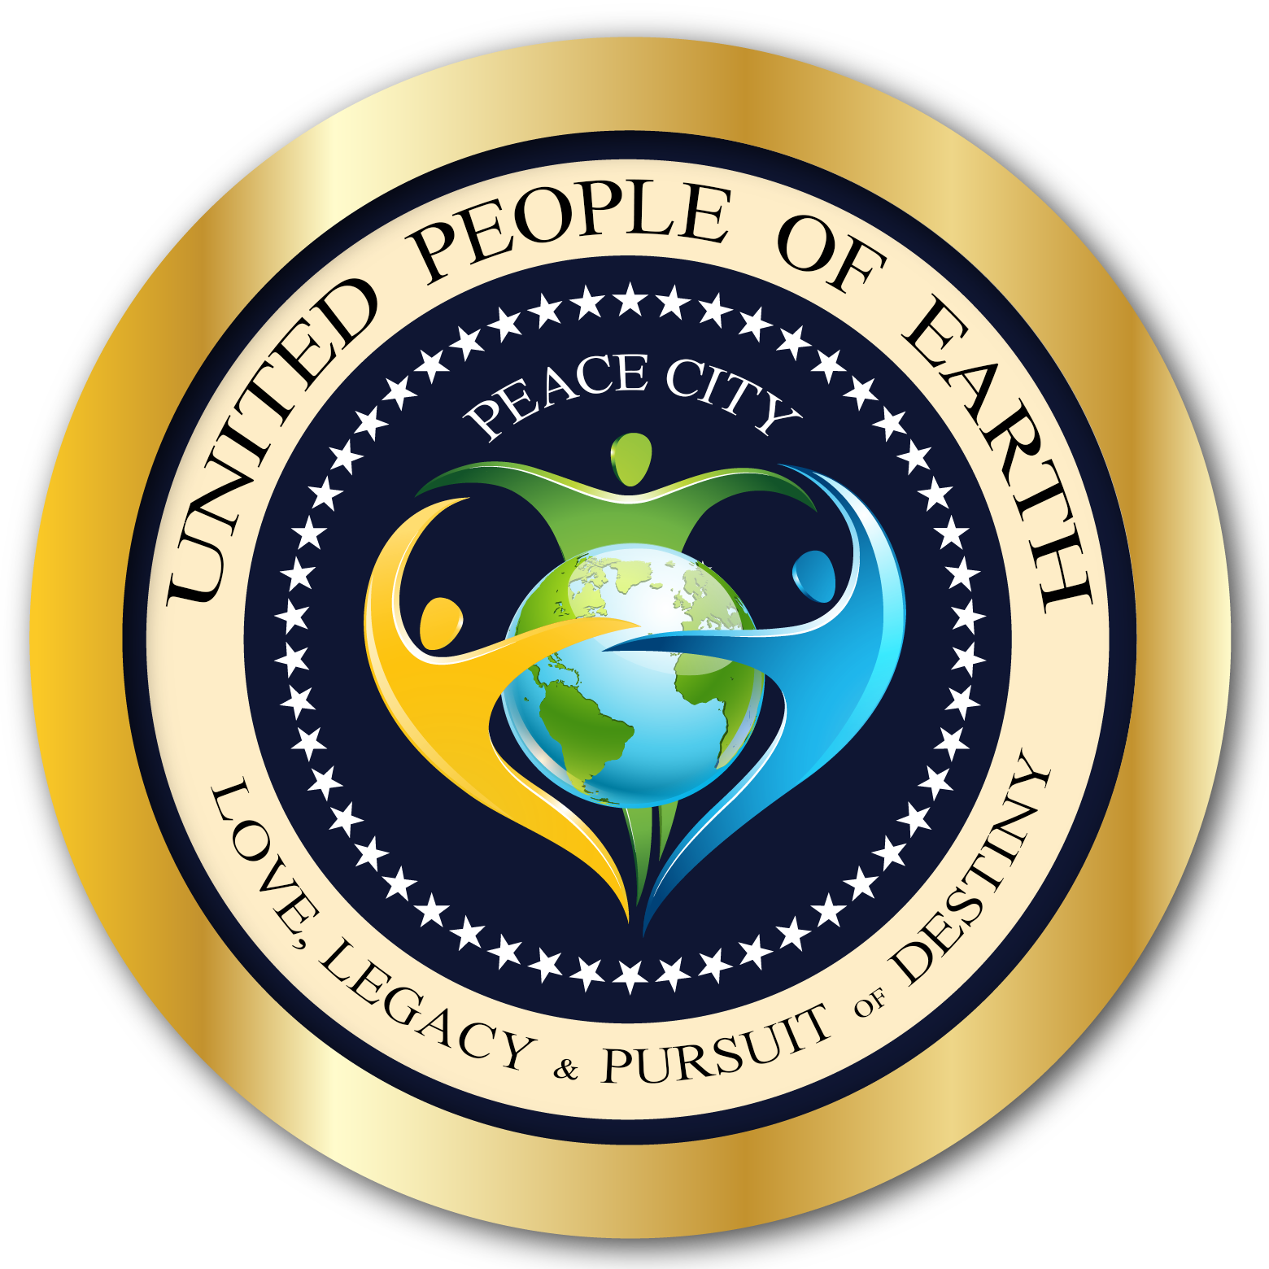
Love Fair
Peace Citizens from
193 Countries & 50 U.S. States
Celebrate Unity &
Visionaries Of The Future
presents

Slide 3
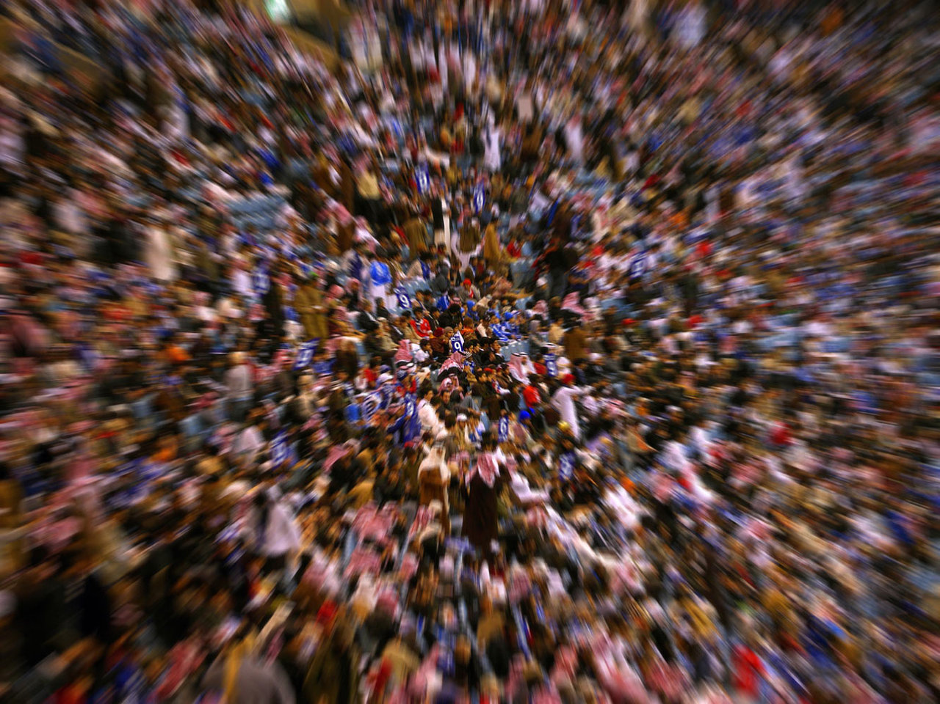
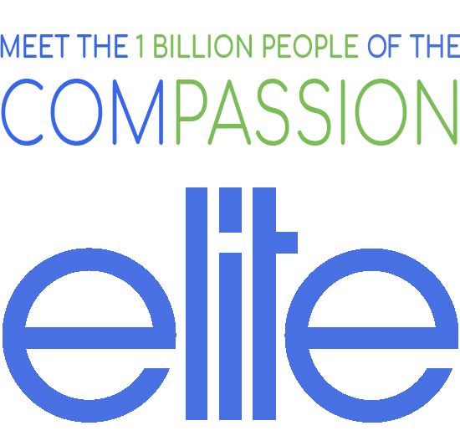
In the past 6 months we have reached out to more than 1 million people in 193 countries. We did this to have a bullet proof statistical answer to one question: How many people care about the kinds of things that make our species fit for the future: Unity, Diversity, Sustainability, Respect for Mother Nature, Ingenuity, Innovation, Equality, and Inclusion of people from all walks of life.
The answer was so surprising, so exciting, so awe inspiring that we have absolute certainty that even though right now things seem uncertain & even scary at times, as a species we can not only survive but thrive:
One in 7 belongs to what we call the compassion elite. People who care more than the average about our relationships with each other and about our relationship with mother nature.
This means that on this planet there are roughly 1 billion people who belong to this compassion elite.
Business people would call this the transformation market. A billion people who will create & buy products for inner and outer transformation. We’ll leave the business implications to the experts to mine this golden fountain. We are motivated by something else:
Imagine this: What if there was a way to bring these 1 billion people together. Imagine what kind of future we can create together ….

Slide 4
THE BIG IDEA IN 162 WORDS
PEACE CITY
Love Fair
For people who turn on the evening news and are unhappy with what they see, Peace City is a new global community in 193 countries that is growing 300x faster than an average of 78 million facebook pages. Peace City is for those who crave commUNITY, broad prosperity, stability, a healthy relationship between people and respect for Mother Nature. And unlike the old stories that are putting our survival at risk, Peace City is about co-creating the most important story of all: The story of us and a future we can be proud of.
On September 1st, people from 193 countries & 50 U.S. States will come together to make history: In an unprecedented event that combines virtual reality with a global live broadcast they will sign a Declaration Of Interdependence. This red-carpet event will also feature a concert, empowering speakers, thought leader panels, awards for visionaries & organizations, convention booths of future tech a dance flash mob & a fashion show.
This inaugural event offers a preview of Peace City and the 2019 event.
A POSITIVE VISION FOR THE FUTURE
THE 3D INTERNET IN VR

Slide 5
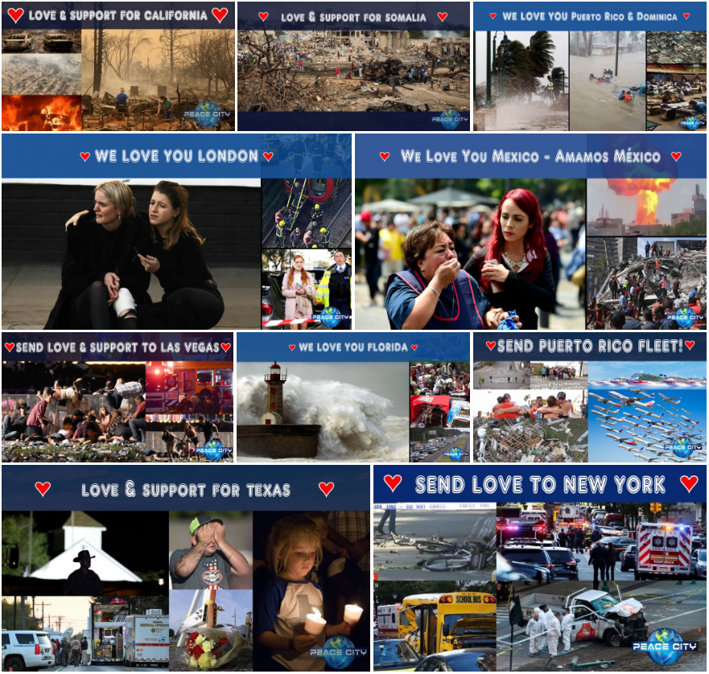
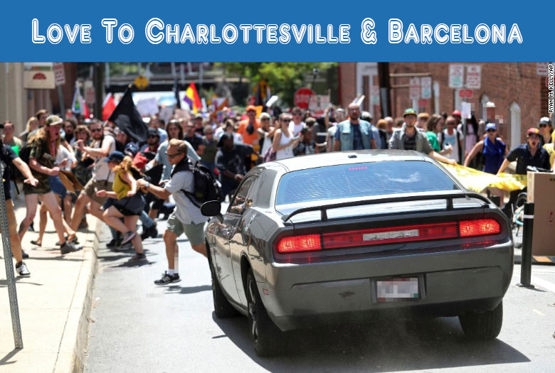
WHY NOW?
There is a change in the world. In 2017 Peace City has rallied more than 100,000 people around the devastating events of a catastrophic year.
Relationships between people and our relationship with Mother Nature are sinking.
It’s like groundhog day. We’ve been using the same old stories pretending they’ll work again. But here’s the reality. The stories of the past are dead. No longer working.
It’s time for an brand-new fresh story. Here’s the good news. There are thousands of people in this country and around the world who are writing this new story. Thought-leaders, Visionaries, Artists, Scientists & every day people. It’s time to bring them all together.
This is what we’re about to do …

Slide 6
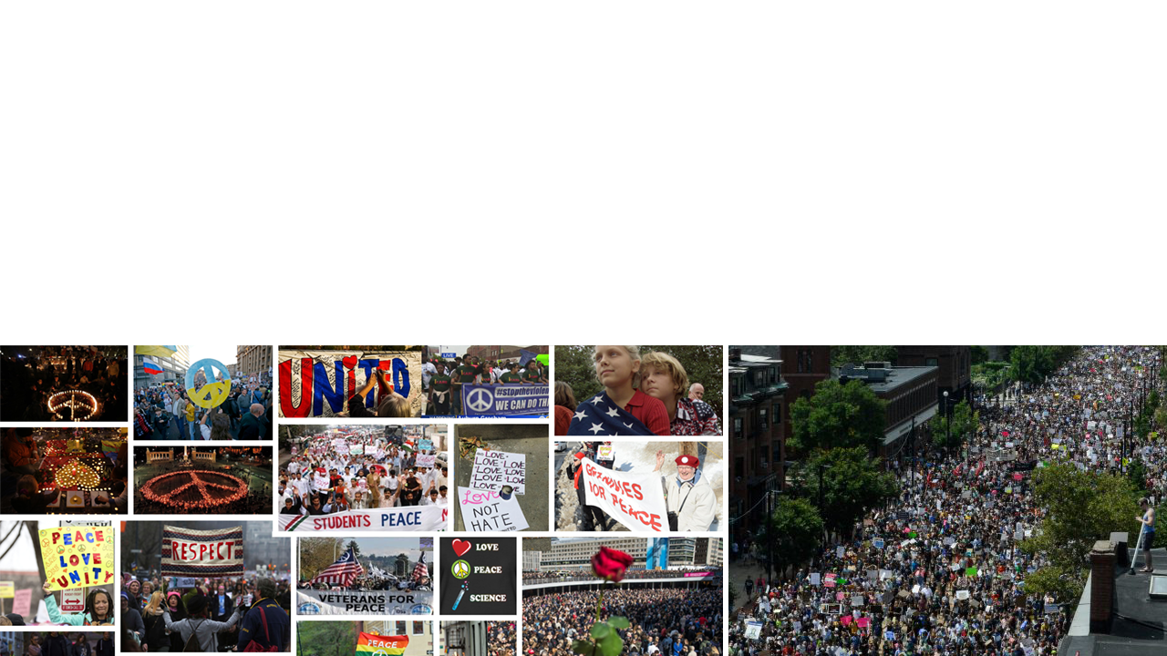
WHY NOW?
PEOPLE ARE HUNGRY FOR A NEW STORY
WELCOME TO THE TRANSFORMATION AGE

Slide 7
Additions in the works
Women’s track
Economics track
Transformation age related product samples

